Slide 1
Lecture 3
CS494 – Information System Audit and Control
16th Feb 2024

Slide 2
Google Classroom ID
veowk7s

Slide 3
Small recap
How are controls implemented ?
Internal controls are normally composed of policies, procedures, practices and organizational structures which are implemented to reduce risks to the organizations
The board of directors are responsible for establishing the effective internal control system

Slide 4
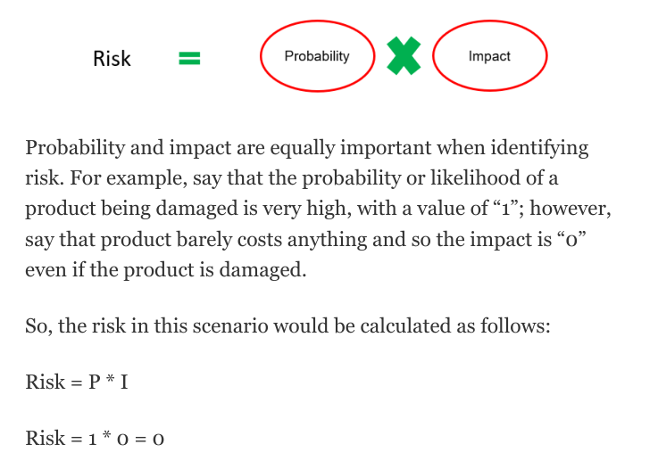
Risk based audit planning
What is Risk ?
The Oxford English Dictionary defines risk as "The probability of something happening multiplied by the resulting cost or benefit if it does.“
Risk-based audit is the deployment of audit resources to areas within an organization that represent the greatest risk.

Slide 5
Vulnerability and threat
Another way of understanding risk is by understanding the notion of vulnerability and threat.
In simple terms, a vulnerability is a weakness, and a threat is something that can exploit said weakness. Again, both elements (V and T) should be present in order to constitute a risk.
There is no threat to a useless system, even if it is highly vulnerable. As such, the risk for that system would be nil in spite of the high vulnerability.
Vulnerabilities are mostly internal. Threats are mostly external.

Slide 6
Examples of Threats and Vulnerabilities
Weak Coding
No anti-virus
Malware
Natural Disaster
Weak access control
Hacker
Criminal

Slide 7
Types of Risks
Audit risk - it is the risk that the auditor fails to detect material misstatements in the financial statements during the audit process
This is influenced by:
Inherent Risk - The risk that an activity poses, excluding any controls or mitigating factors. This is due to the nature of the business.
Control Risk - The risk that a material error exists that would not be prevented or detected on a timely basis by the system of internal controls.
Detection Risk - The risk that material errors or misstatements that have occurred will not be detected by an auditor.

Slide 8
How to minimize “audit” Risk
Conduct risk-based audit planning
Review the internal control system
Select appropriate statistical sampling
Assess the materiality of processes/systems in the audit scope

Slide 9
Inherent risk vs residual risk
Inherent Risk: The risk that an activity poses, excluding any controls or mitigating factors. E.g. driving a car – you “risk” an accident and personal injury.
Residual Risk: The risk that remains after taking controls into account. E.g. wearing a seatbelt reduces risk of personal injury.
Also known as Gross risk vs Net Risk
Formula Residual Risk = Inherent Risk - Controls

Slide 10
Approach towards Risk-based auditing
Step 1 – Acquire pre-audit requirements:
Knowledge about industry and regulatory requirements
Knowledge about applicable risk to the concerned business
Prior audit results
Step 2 – Obtain information about internal controls:
Get knowledge about the control environment and procedures
Understand control risks
Understand detection risks

Slide 11
Approach towards Risk-based auditing
Step 3 – Conduct compliance test:
Identify the controls to be tested
Determine the effectiveness of the controls
Step 4 – Conduct a substantive test:
Identify the process for the substantive test
See that the substantive test includes analytical procedures, detail tests of account balances, and other procedures

Slide 12
Compliance vs Substantive Testing
Compliance testing checks for the presence of controls.
Substantive testing checks for the completeness, accuracy, and validity of the data.
Compliance involves verification of the process.
Substantive involves the verification of data or transactions

Slide 13
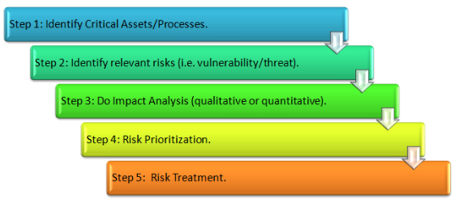
Risk Assessment
IS auditor needs to understand how the organization being audited approaches risk assessment. (show sample risk assessment)
Risk assessments should be conducted at regular intervals to account for changes in risk factors

Slide 14
Risk Appetite
Risk appetite is the amount of risk an organization is willing to take in pursuit of objectives it deems have valuable.
e.g. password control vs 2fA

Slide 15
Risk Response methodology
Risk mitigation/risk reduction: Take some action to mitigate/reduce the risk.
Risk avoidance: Change the strategy or business process to avoid the risk.
Risk acceptance: Decide to accept the risk.
Risk transfer: Transfer the risk to a third party. e.g. ?

Slide 16
Recap of Audit planning
Audit charter
Business Process
Audit universe?
What is risk?
What are controls?
What is a risk assessment?
Risk based audit planning?

Slide 17
Audit Execution
Audit execution processes, such as project management techniques, sampling methodology, and audit evidence collection techniques.
• Audit project management
• Sampling methodology
• Audit evidence collection techniques
• Data analytics
• Reporting and communication techniques
• Quality assurance and improvement of the audit process

Slide 18
Audit project management
Determine Audit Objective
Conduct Risk Assessment
Determine Control Objectives and activities
Determine business processes to be audited
Design Audit plan, resource allocation and identify key stakeholders
Evaluate the Controls
Report the findings

Slide 19
Audit Objective
Audit objectives are the expected outcome of the audit activities. They refer to the intended goals that must be accomplished by the audit.
Determining the audit objective is a very important step in planning the audit activity. Generally, audits are conducted to:
Confirm that internal control exists
To evaluate the effectiveness of internal controls
To confirm compliance with the statutory and regulatory requirements

Slide 20
Fraud, irregularities and illegal acts
The implementation of internal controls does not necessarily eliminate fraud.
The IS auditor should observe and exercise due professional care to ensure that internal controls are appropriate, effective, and efficient to prevent or detect fraud, irregularities, and illegal acts.
In the case of suspicious activity, the IS auditor may communicate the need for a detailed investigation. In the case of a major fraud being identified, audit management should consider reporting it to the audit committee board

Slide 21
Sampling methodologies
Sampling is the process of the selection of data from a population.
By analyzing the selected samples, characteristics of the full population can be concluded.
Sampling is performed when it is not feasible to study the full population due to time and cost constraints.
Samples are a subset of the population.
Why do we need sampling?

Slide 22
Sampling approaches
Statistical Sampling - This is an objective sampling technique. Also known as non-judgmental sampling.
It uses the laws of probability, where each unit has an equal chance of selection.
In statistical sampling, the probability of error can be objectively quantified, and hence the detection risk can be reduced.

Slide 23
Sampling approaches
Non-Statistical Sampling
This is a subjective sampling technique.
Also known as judgmental sampling.
The auditor uses their experience and judgement to select the samples that are material and represent a higher risk.

Slide 24
Sampling approaches
Attribute Sampling
Selecting a small number of transactions and making assumptions about how their characteristics represent the full population of which the selected items are a part.
Stop-or-go sampling
Stop-or-go sampling is used where controls are strong and very few errors are expected.
It helps to prevent excess sampling by allowing the audit test to end at the earliest possible moment.

Slide 25
Sampling approaches
Variable Sampling
Variable sampling contains more information than attribute data.
It answers the questions "how much?".
It is expressed in monetary value, weight, height, or some other measurement—for example, an average profit of $25,000.
Variable sampling is usually used in substantive testing

Slide 26
Sampling approaches
Discovery sampling
Discovery sampling is used when the objective is to detect fraud or other irregularities. If a single error is found, then the entire sample is believed to be fraudulent/irregular.

Slide 27
Sampling Risk
Sampling risk arises from the possibility that an IS auditor’s conclusion may be different from the conclusion that would be reached if the entire population were subjected to the same audit procedure. There are two types of sampling risk:
The risk of incorrect acceptance—A material weakness is assessed as unlikely when, in fact, the population is materially misstated.
The risk of incorrect rejection—A material weakness is assessed as likely when, in fact, the population is not materially misstated.

